Slide 1

General Biology
Dr. sraa nsayef

Slide 2
Laboratory Safety Manual
Lab ((1))

Slide 3
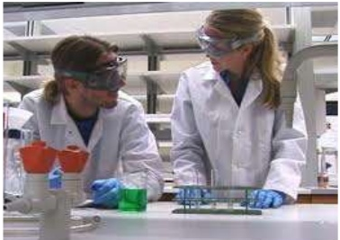
General Safety Rules
1- Wear protect clothing

Slide 4
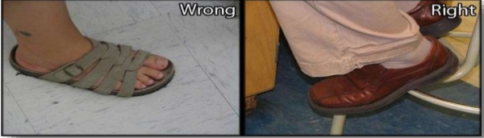
2- Laboratory personnel should not wear sandals

Slide 5

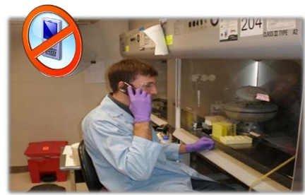
Do not wear Jewelry
Avoid touching objects

Slide 6

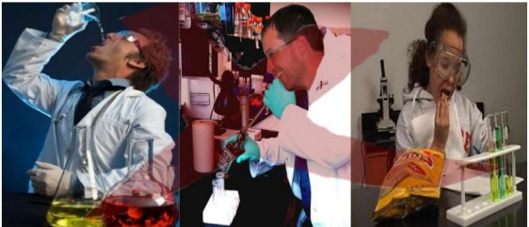
Pencils, labels or any other materials should never be placed in your mouth.
Do not eat food or drink water in the lab.

Slide 7
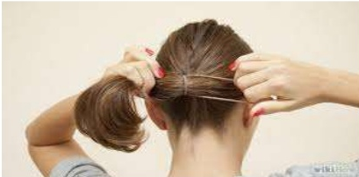
Long hair must be tied back or covered to minimize fire hazard or contamination of experiments.

Slide 8
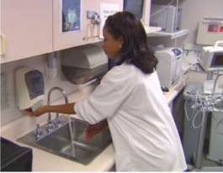
After handling chemicals, always wash your hands with soap and water.

Slide 9
Glassware Safety
1. Chipped or cracked glassware should not be used. Show it to the teacher.
2. Broken glassware should not be disposed of in a classroom trashcan. There is a special glass disposal container for it.
3. If a piece of glassware gets broken, do not try to clean it up by yourself. Notify the teacher.

Slide 10
Chemical Safety
1-Wear protective goggles whenever heating or pouring hazardous chemicals.
2-Never mix chemicals together unless you are told to do so (and then only in the manner specified).
3- Never taste any chemicals (you should never taste anything in the lab).
4- Follow the instructions of your teacher when disposing of all chemicals.
5- Wash your hands after handling hazardous chemicals.

Slide 11
Heating Safety
1. Use tongs and/or protective gloves to handle hot objects.
2. Never reach across an open flame or burner.
3. Always point the top ends of test tubes that are being heated away from people.
4. When heating a test tube, move it around slowly over the flame to distribute the heat evenly.

Slide 12
